Slide 1
EMILY CARR By: Norah Elder

Slide 2
Emily Carr was born on December 13, 1871 and died due to a heart attack on March 2, 1945.

Slide 3
Biography
Emily Carr is a famous artist and writer
She persuaded her family guardian to let her study at the San Francisco school of art
She set up her studio in a barn on the family property and began to teach
Emily Carr is one of Canada's best-known artists
Her life and work reflect a profound commitment to the land and peoples she knew and loved
Emily Carr was influenced by two things called Fauvism and Impressionism

Slide 4
Emily Carr had 4 sisters: Edith, Alice, Elizabeth and Clara. Emily also had 4 brothers: William, Tomas, John and Richard. Emily's mom's name is Emily and her dad's name is Richard.

Slide 5
Emily Carr is important because her art went all over the world and it influenced a lot of people to try different techniques and go to new places.

Slide 6
Canadian Landscapes
Her life and work reflect a profound commitment to the land and peoples she knew and loved. Her sensitive evocations reveal an artist grappling with the spiritual questions that the Canadian landscape and culture inspired in her.

Slide 7
That's why I think that Emily Carr should be on the 5 Dollar bill.

Slide 8
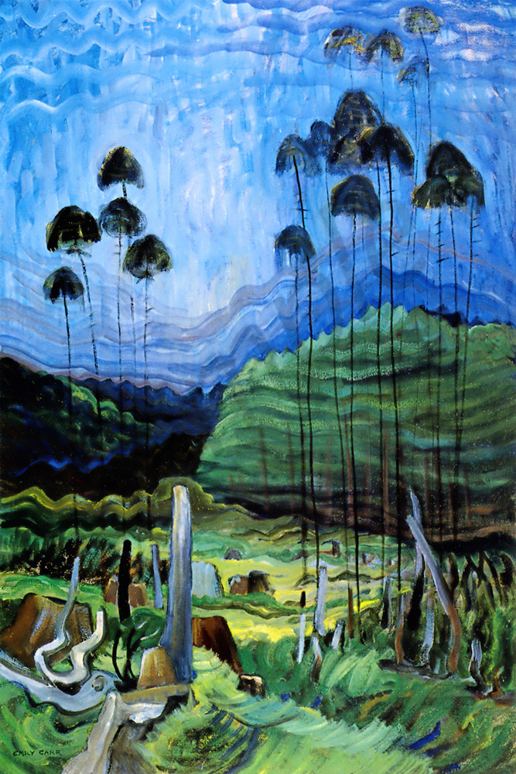
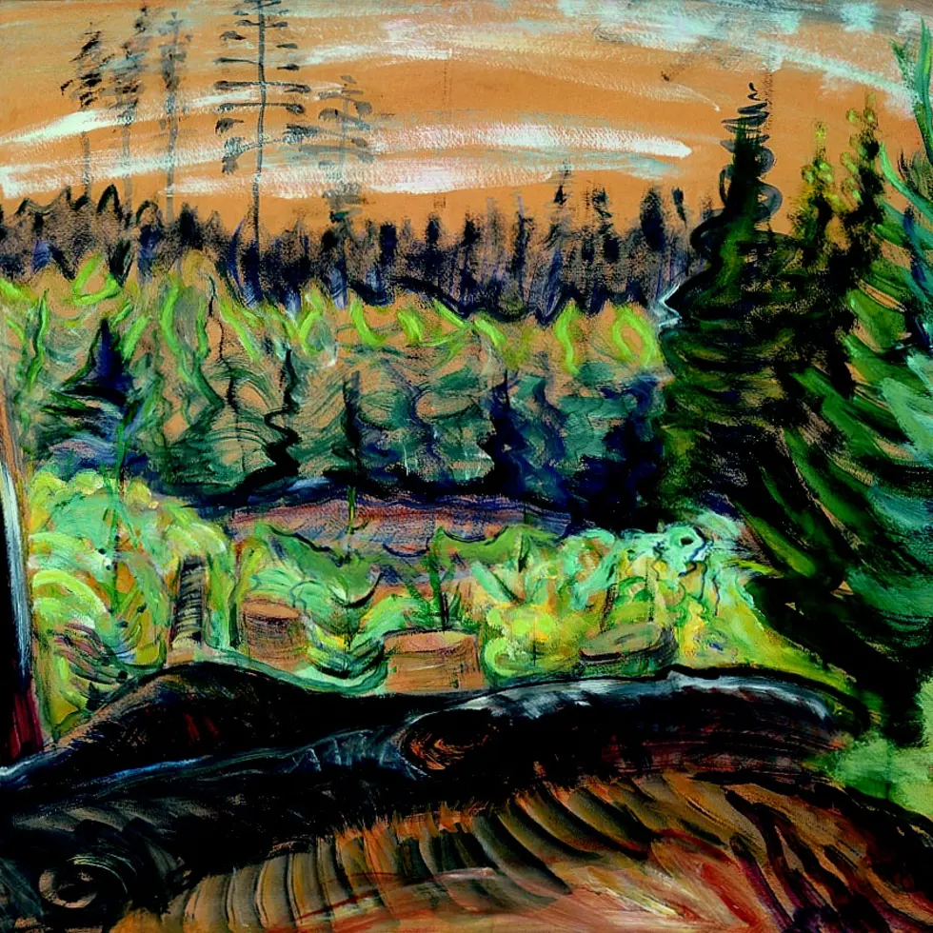
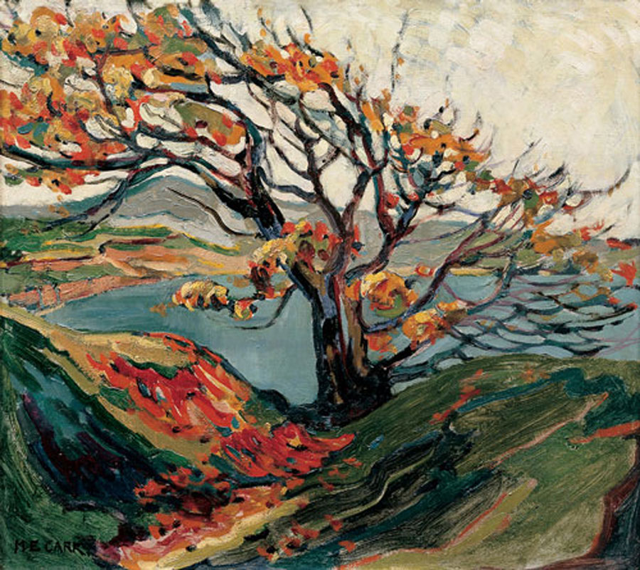
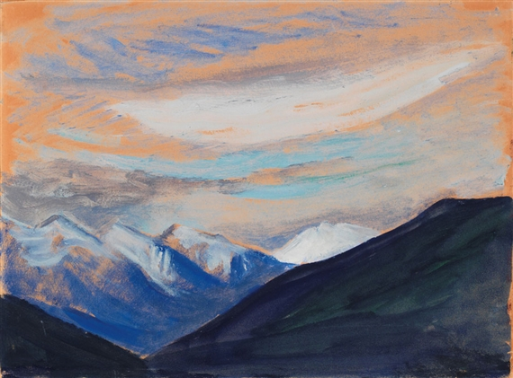
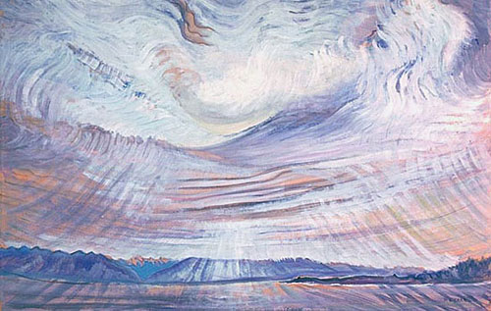
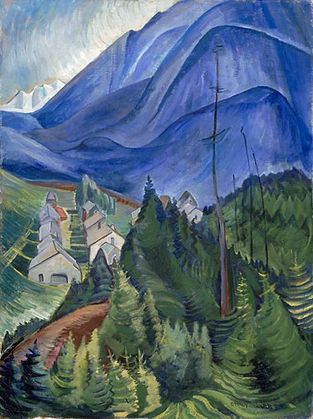
Some of Emily Carr's Art

Slide 9
THE END

